Slide 1
FINDING FUNDS for Oregon Students
Helping students plan & pay for college
Office of Student Access and Completion (OSAC)
Notes:
The Office of Student Access and Completion, located in Eugene, is Oregon’s only state financial aid agency. OSAC was established by the Oregon Legislature in 1959 to administer a variety of state, federal, and privately funded student financial aid programs for the benefit of Oregonians attending institutions of postsecondary education.

Slide 2
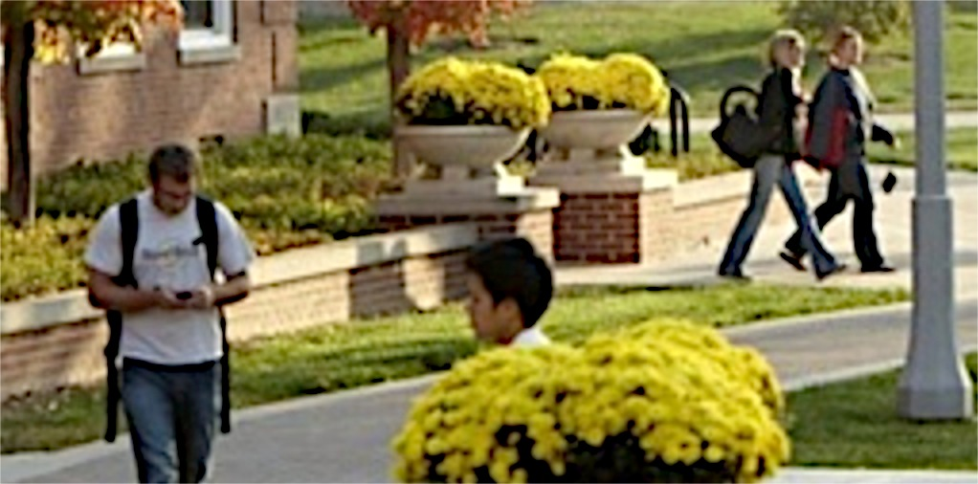
OSAC PROGRAMS
ASPIRE and Outreach
Oregon Opportunity Grant (OOG)
Grants for foster youth, student parents, and more…
OSAC Scholarship Application
www.OregonStudentAid.gov
Notes:
ASPIRE (Access to Student assistance Programs in Reach of Everyone) is the state-recognized mentoring program that assists students with plans for education and training beyond high school.
The Oregon Opportunity Grant (OOG) is the state’s largest state-funded need-based grant program for eligible Oregon students attending public or private nonprofit colleges in Oregon. The application for both the OOG and for Federal Pell Grants and Federal Direct Student Loans is the FAFSA.
OSAC also administers a number of state and federal grant programs for targeted populations such as the Chafee Education and Training grant for former foster youth (federal), Barber and Hairdressers grant (state), Student Child Care Grant (state), and others.
OSAC is unique in the nation for its public-private partnership with donors, offering nearly 500 scholarship opportunities for the benefit of Oregon students. More than 3,700 awards are given annually totaling $18 million. It is a “one-stop shopping” scholarship process that makes it easy for students to apply using one common application. (Small exception: some employer programs and the Ford Siskiyou County scholarship may provide scholarships to non-Oregonians.)
Find links to both the FAFSA and the Oregon Scholarship Application at www.OregonStudentAid.gov

Slide 3
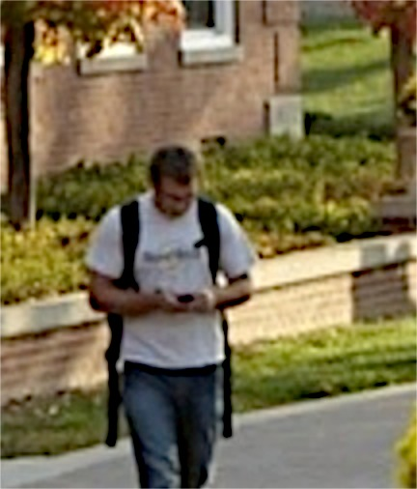
TOPICS TO COVER
Financial Aid Terms
Oregon Opportunity Grant
OSAC Scholarship Program & Application Tips
Notes:
Review topics
You may want to survey your audience to find out their self-evaluated familiarity with financial aid. This will help you determine how much time to spend on explaining the basics of financial aid
For example:
How many of you are very familiar with financial aid?
How many of you have some knowledge of the financial aid process?
How many of you are new or have little knowledge of financial aid?
This is an overview of financial aid. For more information or if you need additional help, contact the Financial Aid Office at the college you plan to attend.

Slide 4
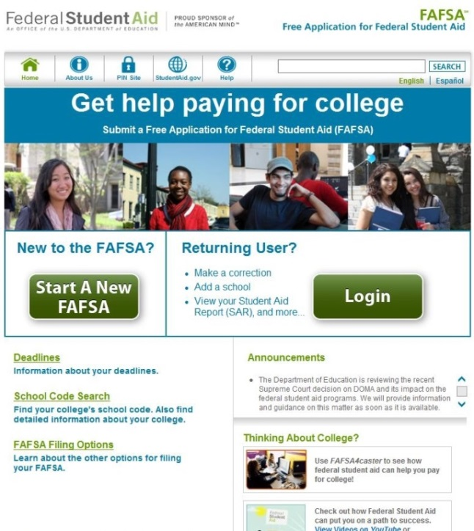
FINANCIAL AID TERMS
FAFSA (Free Application for Federal Student Aid)
Used to evaluate a student’s financial need and ability to pay
Calculates the Expected Family Contribution (EFC)
Required each year
www.fafsa.ed.gov
www.fafsa4caster.ed.gov
Notes:
The Free Application for Federal Student Aid, often referred to simply as “the FAFSA,” is the application for the Federal Pell Grant, federal student and parent loans, and the Oregon Opportunity Grant
Beware of www. fafsa.com (It’s a site that charges students.)! The real federal site is www.fafsa.ed.gov.
Students do not have to wait until they file taxes to complete the FAFSA. They can estimate taxes and update that information later after they and their parents have filed their tax returns. Both parents and students must “sign” the FAFSA for dependent students. Students and parents can use the IRS retrieval process to update the FAFSA with actual data after they file taxes.
Must list at least 1 school to submit the FAFSA. To be considered for an Oregon Opportunity Grant, list at least one school in Oregon too.
Make corrections as soon as possible to avoid missing your college financial aid deadline. Check with the college you will be attending for additional information.
The US Department of Education’s processing system uses data from the FAFSA to calculate each student’s Expected Family Contribution. More on that in a moment.
Seniors before Jan. 1, and juniors and younger students can use the FAFSA4caster to receive an early estimate of eligibility for federal student aid.

Slide 5
FINANCIAL AID TERMS
Need-based aid
Determined by FAFSA data and/or other statement of financial need
VS.
Merit-based aid
Determined by other factors: talent, academics, interest, etc.
Notes:
Need-based aid: Federal Pell Grants and Oregon Opportunity Grants
Merit-based aid: Some scholarships may be based on a combination of merit and need.

Slide 6
FINANCIAL AID TERMS
Grants
Eligibility based on financial need
No repayment required
Scholarships
Eligibility based on EFC, remaining need, merit, or a combination
No repayment required
Work study
Awarded by the college using FAFSA information
Notes:
Review each item
This slide focuses on aid that does not have to be paid back -- grants and scholarships.
Most of the scholarship information can be used for applying for all types of scholarships, not just OSAC Scholarships
Work Study – Both Federal Work Study and institutional work study programs may be available.

Slide 7
FINANCIAL AID TERMS
Student Loans
Federal and Private Loans
Must be paid back
Federal Education Tax Credits
American Opportunity Tax Credit: Up to $2,500 annually
Lifetime Learning Credit: Up to $2,000 per family per year for additional years
www.irs.gov
Notes:
For Student Loans: Students apply for a federal student loan by filing the FAFSA. All federal student loans also require students to complete and sign a Master Promissory Note that forms the basis for their federal loan agreement.
For private loans, students will also need to complete a separate application and promissory note. Some private loans also may require a co-signer or endorser.
Tax Credits
Educational income tax credits can reduce your or your parents' federal taxes. The IRS website (www.IRS.gov) has excellent information about federal education-related tax credits. There’s even an Interactive Tax Assistant tool on the IRS website to help you determine if your eligible for educational credits or deductions. You can also contact a tax professional for details.
American Opportunity Tax Credit – extended through December 2017
American Opportunity Tax Credit is a credit for qualified education expenses paid for an eligible student for the first 4 years of higher education. Tax filers can get a maximum annual credit of $2,500 per eligible student. If the credit brings the amount of tax owed to zero, tax filers can receive a refund of 40 percent of any remaining amount of the credit (up to $1,000).To be eligible, a student must be in a certificate- or degree-granting program, be enrolled at least half time, and not have claimed the AOTC or the former Hope credit for more than 4 tax years. Credits are available to single-filers with adjusted gross incomes up to $80,000 and to married filers with AGIs of up to $160,000. Credits are reduced for AGIs of up to $90,000 for singles and $180,000 for married filers, and are not available to those with incomes above those amounts.
Lifetime Learning Credit
The Lifetime Learning Credit is for qualified tuition and related expenses paid for eligible students enrolled in an eligible educational institution. This credit can help pay for undergraduate, graduate and professional degree courses--including courses to acquire or improve job skills. There is no limit on the number of years you can claim the credit. It is worth up to $2,000 per tax return.

Slide 8
Oregon Opportunity Grant

Slide 9
OREGON OPPORTUNITY GRANT
Must file FAFSA by February 1, 2015
$2,000 Award (full-time)
Oregon residents attending Oregon institutions
Awards are made first-come first- served until the funds run out
OSAC will notify OOG awardees by email of their award
www.fafsa.gov
Notes:
Oregon Opportunity Grant
The FAFSA is the application for the Oregon Opportunity Grant. File your FAFSA and indicate the Oregon college you plan to attend or the Oregon colleges you are considering.
For 2015-16, the application deadline is February 1, 2015.
The maximum award amount is $2,000 for full-time, full-year enrollment.
File the FAFSA as soon as possible after January 1 even if you are not sure you will attend college in the fall. Funding for the OOG is limited; grant awards are made until funds run out. Early FAFSA filing along with early application to college will increase your chances of receiving these funds.
Reminder: Applying by the deadline doesn’t guarantee an award. Students must also resolve any errors on their FAFSA right away because we can award only those only students who have no error codes on their most current FAFSA record.
In March, OSAC will notify potentially eligible applicants via email. Emails are sent to the address the students lists on the FAFSA. This is also the email the US Department of Education uses to notify students of the results of their FAFSA.

Slide 10
Other Public Grant Programs at OSAC
Chafee Education and Training Grant
Tuition and Fee Waiver for Foster Youth
Deceased or Disabled Public Safety Officer Grant
Student Child Care Grant
www.OregonStudentAid.gov
Notes:
Chafee Education and Training Grant – Federal grant for former foster youth. Awards up to $3,000 annually. Oregon Dept of Human Services approves eligibility, and OSAC disburses funds to schools. Application Deadlines: August 1 (fall); November 1 (winter); February 1 (spring); May 1 (summer)
Tuition and Fee Waiver for Foster Youth – For current and former foster youth at Oregon community colleges and public universities. Eligibility is determined by DHS. Awards the difference between Pell Grants and OOG received and tuition and fees. Each year, recipients must also complete 30 hours of community service to renew the waiver.
Deceased or Disabled Public Safety Officer Grant – For children of public safety officers killed or disabled in the line of duty. Awards up to full tuition & fees, depending on student’s financial resources and cost of attendance. Application is available on OSAC’s website. No application deadline but it’s best to submit as soon as they file their FAFSA.
Student Childcare Grant – Award based on age and number of children. The application process for the 2015-16 academic year will open on January 15, 2015. Priority in awards is first for prior recipients who continue to meet all eligibility criteria, and then to new applicants based on need, credits earned to-date, and enrollment status. The deadline is May 30, 2015.

Slide 11
OSAC Scholarship Program

Slide 12
OSAC Scholarship Application
Nearly 500 scholarship programs
$18 million awarded annually
Average award is $2,000
3,700+ awardees
Multiple scholarships in one easy application!
Anyone can start an application even underclassmen!
Email notifications
www.OregonStudentAid.gov
Notes:
Scholarship opportunities are generous donation of private individuals, businesses, civic organizations, employers, foundations and financial institutions for Oregon graduating high school seniors, college undergraduates, graduate students, community college and transfer students, and students with specific needs or circumstances, such as part-time and returning older students, military veterans, foster youth, home-schooled and GED students.
Award amounts range from $500 to $10,000 or more. 28% of the awards are at least $5,000
Use the links at OregonStudentAid.gov to access websites for both the FAFSA and the Oregon Scholarship Application.
OSAC Scholarship Application. Students need to fill out only one common application for nearly 500 scholarship opportunities available through OSAC, making applying very easy. Email notifications: students need to make sure they are receiving notifications from OSAC . A great test is the first email when they create an account, if they don’t receive the email they need to find out why – junk mail- have not approved OSAC to be dropped into mail box. Check with OSAC.
High School Freshman, Sophomores, & Juniors can begin their scholarship application (test applications), but cannot submit until their graduation year.

Slide 13
OSAC Scholarship Program Deadlines
February 15, 2015
Priority deadline for Early Bird
If error-free, enter a drawing for a $500 scholarship; many available
5:00 pm (PST)
March 1, 2015
FINAL deadline
OSAC Scholarship Applications & all required documents must be submitted to OSAC by 5:00 pm (PST)
www.OregonStudentAid.gov
Notes:
OSAC begins early review of submitted applications in mid-January.
February 15 is the Early Bird deadline. To receive an early review of your application for errors, your application & all required documents must be received at OSAC by 5:00PM PST. If you submit by February 15, make sure that you upload or send in the correct transcript with your application.
You will receive a chance to make transcript corrections only (in a timely manner).
Error-free applications are entered into a drawing for a $500 OSAC scholarship.
ALL materials must be received by 5:00PM by the deadline of March 1
OSAC scholarship application site traffic may be heaviest a few days before the deadlines of February 15 and March 1, so get your application submitted early.
In the event that a Scholarship Application deadline falls on a weekend or holiday, the deadline will automatically be extended to 5:00 p.m. (PST) of the following business day.
Some callers may be concerned about the Early Bird deadline, because it falls on a Saturday, and the following Monday, Feb 17 is President’s day. Though OSAC is open that day, it is a national holiday for most. So, the actual deadline will be Feb 18, 2015 – 5:00 p.m. (PST) – the next business day for most schools, banks, post office, etc.

Slide 14
OSAC Scholarship Programs
Non-citizens
No Financial Need
Employer/Member Programs
Graduate Programs
High School
Seniors

Slide 15
Scholarship Programs
Ford Scholars
Graduating HS seniors & community college transfer students
Bachelor's degree at an eligible Oregon college
Ford Opportunity
Single parents "head of household"
Bachelor's degree at an eligible Oregon college
Ford ReStart
For adults, age 25 years or older, beginning or returning to postsecondary education
Certificate, associate’s or bachelor’s degree at an eligible Oregon college
Be less than halfway through the completion of degree program
Ford Sons & Daughters
For dependents of employees of Roseburg Forest Products Co.
fordscholarships@tfff.org | (541) 942-0527 | www.tfff.org
Notes:
Ford Program eligibility questions should be sent directly to TFFF staff.

Slide 16
Oregon College Savings Plan
Major: Education
GPA: High school 3.00+, college 3.25+
Oregon public and nonprofit colleges
Gray Community College
Undergrads 2.50-3.50 GPA
Oregon community colleges only
Officer Chris Kilcullen Memorial
College junior and above
Service and community-focused career
Gayle and Harvey Rubin
Major: Law or Medicine
Graduate students
Notes:
You don't need to be a merit scholar or a student with financial need to apply for OSAC scholarships. All types of scholarships are available. Many are based on criteria such as, the high school you attended, your academic interests, your school and community activities, or your career goals. Some require a minimum GPA and others require no GPA whatsoever. There are more nearly 500 scholarships programs and you may qualify! But you won't know unless you apply. Search the OSAC Catalog for eligible scholarships.

Slide 17
Application Requirements
Student Profile
4 Personal Statements
Activities Chart
Transcripts
Scholarship-specific essays and other documents may be required
www.OregonStudentAid.gov
Notes:
The Application requires 4 Personal Statements, Activities Chart, transcripts, and possibly additional essays
Transcripts
Graduating high school seniors are required to submit transcripts with complete grades through fall term: first semester, trimester or second quarter. College students submit transcripts that include all coursework through fall semester/term, unless most recent coursework is more than 10 years old (see detailed Transcript Instructions online).
Three options for submission:
High school submits electronically
Student scans and uploads
Student sends hardcopy by the deadline (blacken or white-out social security number)
Extra required documents for specific scholarship programs must be scanned and uploaded to the student’s application. Instructions are available in the online application. Many people choose not to apply for these scholarships because of the extra work. This raises your chances of being awarded a scholarship.

Slide 18
Application Student Profile Page
Your Personal “go-to” page
What can you do in your Student Profile?
Print your application
Verify application accepted
Accept/decline scholarships
Update your personal contact info, college choice, and college major
Check your Student Profile often for messages from OSAC about your application!
www.OregonStudentAid.gov
Notes:
Once your OSAC Scholarship Application has been submitted to OSAC, check your Student Profile often for your application status message. If it says “Review Pending,” keep checking back until it says “Valid Application Accepted.” If it says, “Application Problem,” make the correction and submit by the deadline indicated in your status message.
CHECK YOUR PROFILE FREQUENTLY for status of scholarships
Begin checking in late April to see if you have been awarded a scholarship and if awarded, accept or decline it online. Check back often. Scholarships are awarded through August.
If there is a change in your name, address, phone number, email, college, or major, log in and update your information.
Save time applying each year by logging into your Student Profile (with user name and password) during the new application year and update your previous application, including your required Activities Chart and four short Personal Statements.
OSAC’S primary means of notifying applicants is through the Student Profile and email, so remember to keep your email address current, and check them both regularly.
After submitting the online application, check often!

Slide 19
OSAC Activities Chart
You can:
Begin to add activities
Certify that you have no activity in a specific category, if applicable
Import your CIS Activities
Activity list:
A. School Activities
B. Volunteer Activities (Community/Family)
C. Paid Work History
Include:
Dates
Hours (time spent)
Responsibilities/Accomplishments (115 characters)
Notes:
Tells what you have been doing.
OSAC requires the Activities Chart as part of its application. The Chart is important to selection committees who want to see leadership, decision making, organizational skills, and areas where you received special recognition and participation in activities, volunteer service, and work history.
You may import your Activities Chart from CIS (Career Information System) directly into your Application, but only if your school uses this program: Be aware that the Application has limited characters and you may need to edit your Activities Chart. Directions are available at www.OregonStudentAid.gov.
You can also copy and paste information into the Activities Chart by using the a template available on our website www.OregonStudentAid.gov.
The limit is 20 activities
Give a reasonable estimate of time spent
Try not to use abbreviations

Slide 20
Personal Statements
1000 characters (approx. 150 words)
1. Explain your career aspirations and your educational plan to meet these goals. Be specific.
2. Explain how you have helped your family or made your community a better place to live. Provide specific examples.
3. Describe a personal accomplishment and the strengths and skills you used to achieve it.
4. Describe a significant change or experience that has occurred in your life. How did you respond and what did you learn about yourself?
Notes:
Tells who you are.
Required four Personal Statements. The intent is to provide an opportunity to write about something not covered in the application or Activities Chart. The answers give selection committees a broader picture of you than just relying on GPA, test scores, and transcripts.
Some of the statements have 2 parts – make sure to answer/address both
More tips on writing your Personal Statement will be provided in a moment.
The key to remember is to keep your Personal Statements short and concise at no more than 150 words approximately 1,000 characters. If you use MS Word, you can go to Tools in your menu and select “Word Count”. Then cut and paste your personal statement into your Scholarship Application.
Spell check.
To best assure all characters/words are available to selection committees; print out a hard copy of your Application and verify what appears in your Personal Statement section.

Slide 21
Transcripts
# 1 reason for a rejected OSAC application:
A missing or incomplete transcript
High school seniors – usually available in January or February
Home-schooled students – additional requirements
College students – include grades through fall
Unofficial transcripts are accepted
Transcript for each college or school attended
Full instructions on the website
Notes:
Transcripts
A missing or incomplete transcript is the #1 reason for a rejected OSAC scholarship application. Read these instructions to ensure that you are submitting what OSAC needs in order to process your application.
OSAC does not require official transcripts. You can submit transcripts printed from your high school or college website, as long as they include the information listed above. Do not copy and paste from the school website, it will be rejected.
If you attended more than one college, submit a transcript for each college, including work on prior degrees. You may submit one transcript with transfer credits for other schools, provided it includes grades, gpa, cumulative gpa, and credit hours for each school and course: summarized transfer credits alone are not enough.
Transcripts sent to OSAC via e-mail will NOT be accepted. You must either upload your transcript, mail/hand-deliver it, or have your school upload it.

Slide 22
How do students receive scholarships?
Students
Accepts award through online OSAC Student Profile
Notifies OSAC w/any changes: address, school, etc.
School
Verifies eligibility
Receives funds from OSAC at beginning of the term
Issues? Contact the financial aid office and then OSAC
www.OregonStudentAid.gov
Notes:
Students - If selected for an award, you…
1. can log into your Student Profile with your user name and password and accept your scholarship award,
2. can update your college choice, college major, and personal information (name, address, e-mail address, and phone number) by completing the update form in your Student Profile,
3. can write a thank you letter to the donor of your scholarship award in care of OSAC, 1500 Valley River Dr. Suite 100, Eugene OR 97401.
INFO ON AWARD LETTER
Scholarship Acceptance
Accept online at www.OregonStudentAid.gov or sign and return this form within two weeks of the date of notification.
Failure to accept this award may delay or terminate your award and delay awarding an alternate recipient.
Enrollment
If you transfer schools or are enrolled at two or more schools at the same time during the academic year, notify OSAC early to allow time to process the change.
Scholarship Disbursement
OSAC sends funds to your school financial aid office prior to the beginning of each term/semester. Your scholarship award is prorated for each term/semester. If you do not attend school for a term(s), you will not receive that portion of your award.
You must maintain the required enrollment status & satisfactory academic progress to receive disbursements throughout the year.
Scholarships must be used for educational expenses as defined by your school. These include tuition and fees, room and board, books, transportation, and education-related personal costs.

Slide 23
TIPS for Success

Slide 24
Seeking Scholarships
Tip #1
High School College/Career Center
Colleges (including depts.)
OSAC Scholarship Application
Local Search: Student/Parent Employers; Member/Civic Organizations; Foundations
National Search: Gates Millennium Scholarship Program, Coca-Cola, Duck Tape and national scholarship search engines
Do not pay for search tools – use the FREE ones!
Notes:
State: OSAC includes: The Ford Family Foundation (biggest in the state), Oregon Community Foundation, misc donors, etc.
Examples: LOCAL Rotary, Kiwanis, Elks etc, STAMPS (UO)
Nationwide: Duck Tape Scholarship, Gates Millennium Scholarship, Coca Cola

Slide 25
Tip #2
Scholarship Search Engines
OSAC – www.OregonStudentAid.gov
College Board – www.bigfuture.collegeboard.org
Career Information Systems (CIS) – www.oregoncis.uoregon.edu
Report scams to the Federal Trade Commission – www.ftc.gov
Notes:
Most Search Engines will…
Ask you questions that relate to scholarship criteria
Search their database for matches and send you results via email
Allow you to send for the application and complete it by the deadline
If your school subscribes to CIS – look in the Financial Aid Sort for scholarship opportunities
OSAC is not endorsing those listed above, but they have proven to be legitimate sites
You should NEVER pay for scholarship services

Slide 26
Tip #3
What Selection Committees Consider
Academics
GPA, course rigor, transcripts, and test scores
Outside the Classroom
Volunteer activities, leadership, work, etc.
Life Experiences
Serving your community, helping your family
Tell your unique story using your four Personal Statements, Activities Chart, and transcript
Notes:
3-legged stool that selection committees look for
What students need in place to compete for scholarships.

Slide 27
Tip #4
Writing Essays or
Personal Statements
Answer the question
Consider the reader
Don’t repeat information (like your GPA)
Be original, creative, and honest
Be clear and purposeful about your academic and career goals
Be careful about using too much humor
Notes:
These tips apply to all types of scholarship essays
Presenter may read essay examples here.
Readers are often educators who care deeply about punctuation and grammar.
Don’t recycle an essay unless it matches the topic, and even then you should “customize” it.
Transcripts will show your GPA, don’t use your essay space repeating.
Say what you have accomplished, not what you didn’t do or are hoping to do that you wish now you had…example volunteer work.
Humor is risky and easily misunderstood - be wary.
Show your commitment. Make every sentence and word have a purpose.

Slide 28
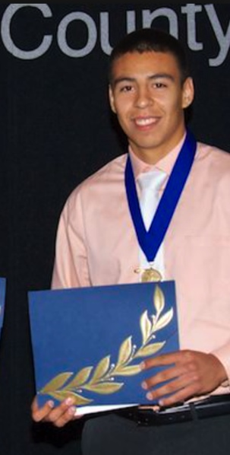
Tip #5
Promote Yourself
In what ways are you unique?
What are your leadership qualities?
How do you take initiative?
Any special recognition?
Put YOU on paper
Passion with a purpose
Notes:
Don’t be modest! Remember that you are asking people to give you money! Why should they?
Your application and essays are a way for the scholarship committees to get to know you
Stay focused – don’t wander off your topic

Slide 29
Tip #6
Proofread and Get Feedback
Print it out and read it slowly
Read backwards sentence by sentence
Read out loud and silently
Take a break and review again
Have someone else proofread your essays
Notes:
Print it out and read it
Read backwards to focus on spelling
Read out loud and silently
Read it slowly
Take a break and review again
Have someone else proofread your essays
Friends/family
Office/job associates
Professors/teachers
Learning resource centers
Writing centers

Slide 30
Tip #7
The Interview
Remember your audience
Reread your Application & Personal Statements/Essays
Practice your interview skills
Make a positive first impression
Establish eye contact
Display poised, confident body language
Dress business casual
Be yourself
Shake hands firmly and remember names
Arrive early
Notes:
Remember who is interviewing you!
Practice your interview skills but don’t expect that any set of specific questions will be asked. Your school may set up mock interviews but the questions asked will not be the same as in the scholarship interview.
More tips:
Plan to arrive early and find the building and/or room where you are expected. GPS/Mapquest directions
Leave a few minutes to relax. Take a little walk or read a book.
Shake hands when you are introduced and memorize interviewers names for thank you card later.
Thank the interviewers for the opportunity.
Stay calm!
Not every scholarship has an interview process

Slide 31
OSAC COMMUNICATIONS

Slide 32
OSAC Communications
Podcast Topics
The OSAC Scholarship Application, American Tax Credit, Avoiding Scholarship Scams, etc.
Follow OSAC on Twitter and Facebook
Receive updates on new scholarships, tips during the scholarship season, reminders, and more!
Tip Sheets
How to analyze College Financial Aid award letters, What you need to know about student loans, and more!
www.OregonStudentAid.gov
Notes:
Podcast Topics
Avoiding Scholarship Scams, the OSAC Scholarship Application, American Tax Credit and more!
Receive updates during the application season through
Join us on Twitter and Facebook
Follow OSAC on Twitter.com/OSAC to keep apprised of deadlines, alerts, and new scholarships being added
The OSAC guide is a snapshot in time. We will continue adding to it through the application deadline of March 1. Updates are posted on Twitter and Facebook
Like us on Facebook at facebook.com/OSACscholarships
Timely Tip Sheets – www.OregonStudentAid.gov
How to Analyze College Financial Aid Award Letters; What You Need To Know About Student Loans and more!

Slide 33
COLLEGE GOAL OREGON
www.CollegeGoalOregon.gov
FAFSA help for students and families
One-day events in January
Year-round FAFSA completion activities
Notes:
Students get help to complete a FAFSA
20+ sites around Oregon including universities, community colleges, tribes, high schools, and YMCAs
Communities select any date in January for their one-day event
Year round events too
Check the website for your closest event and date
You can help
Apply to be a site
Volunteer for a College Goal Oregon event

Slide 34
Thank you for attending
“Finding Funds for Oregon Students”
scholarshipapphelp@osac.state.or.us
www.OregonStudentAid.gov
Office of Student Access and Completion
Notes:
Encourage students to call or use the feedback form if they need assistance, remind them that we have staff available. The feedback form will be the most timely response.

